Slide 1
有機分子のアセチリド化によるナノワイヤー作成：
各種置換基の影響と機能性分子のナノワイヤー化
明星大理工 〇西條純一，和田友明，石崎真也，若杉崇志，
奥山隼斗，坂下大樹，佐々木一樹

Slide 2
Introduction

Slide 3
Nanowires are attractive candidates for
many applications such as...
・Wiring material
・Catalyst support
・Anti-bacterial coating
・Medical-diagnosis
・Optical material etc.

Slide 4
At the same time, the application of nanowires has been limited by the difficulties in the preparation.
Desirable preparation method:
・Facile and Mass-productive
→ Self-assembly is suitable
・Applicable for various materials
We focused on "Ag- and Cu-acetylides"
(M-C≡C-R)
Notes:
1分弱

Slide 5
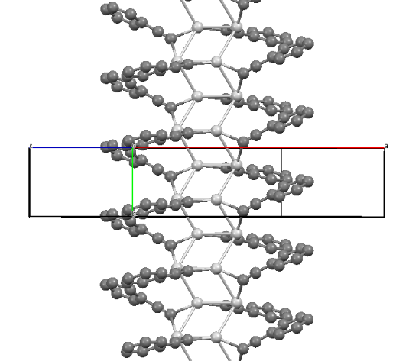
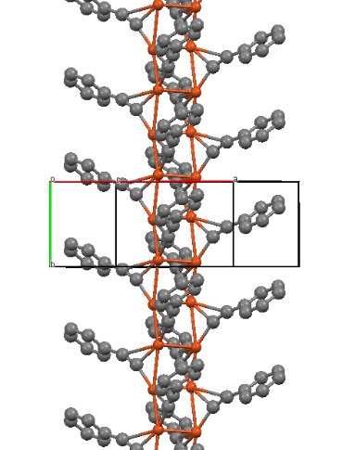
Why Ag/Cu acetylide?
1. Extremely anisotropic crystal structures
in the case of M-C≡C-Ph
Ag-C≡C-Ph
Cu-C≡C-Ph
powder XRD, S.S.Y. Chui et al., Chem. Eur. J., 1739 (2005).
Quite thin and long needle crystal (= nanowire)
J. Nishijo et al., Chem. Mater., 19, 4627-4629 (2007).
Notes:
2分弱

Slide 6
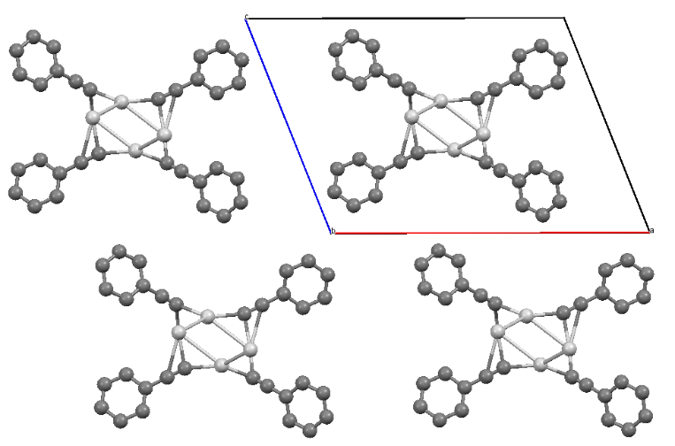
Why Ag/Cu acetylide?
2. Small contribution of phenyl group to the structures
Anisotropic structure is mainly originated from the metal cations and ethynyl groups.
M-C≡C-R is likely to grow into nanowires
regardless of terminal functional groups.
Notes:
3分弱

Slide 7
In short...
various organic molecules (R)
introduction of an ethynyl group
R-C≡C-H
Cu⁺ / Ag⁺ (acetylide)
Nanowires
Versatile method to construct nanowires
Notes:
3分15秒

Slide 8
The aim of this study:
Is this method really "versatile"?
Elucidate the limitation of the applicability
Notes:
4分弱

Slide 9
Experimental

Slide 10
1. Preparation of acetylides
AgNO₃ or CuCl: 6 mmol
Stir 12-24 h, then filtered.
Washed with CH₃CN
(and MeOH).
R-C≡C-H: 7-8 mmol
Et₃N (base): 7-8 mmol
CH₃CN (solvent): 50 ml
SEM observation
If not nanowire
Recrystallization
SEM
Notes:
4分30秒

Slide 11
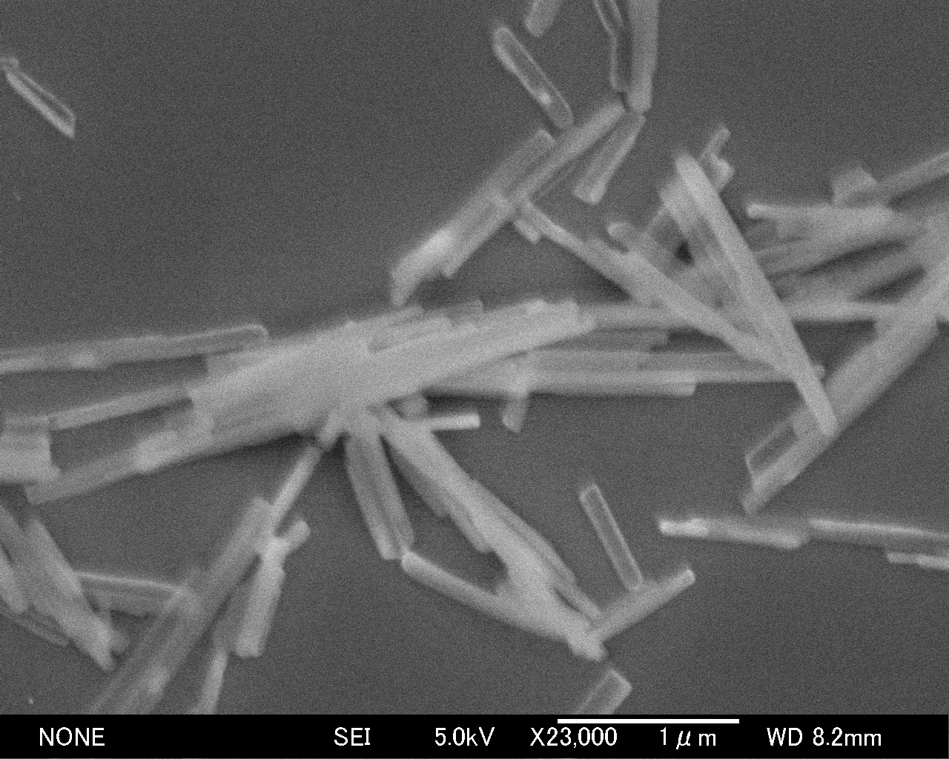
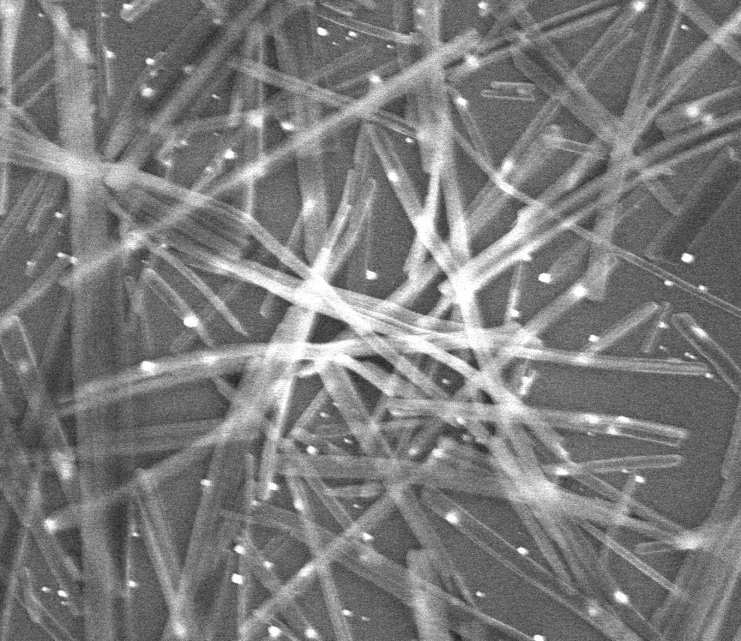
2. Recrystallization
Most of the obtained acetylides are insoluble.
Therefore, we convert them into soluble complexes, followed by reprecipitation caused by dilution.
PMe₃
-PMe₃
[M-C≡C-R]∞
[Me₃P-M-C≡C-R]
[M-C≡C-R]∞
(insoluble)
(soluble)
dilute
(insoluble)
1 μm
1 μm
Ag-C≡C-Ph (AS prepared)
Ag-C≡C-Ph (recrystallized)
Notes:
5分30秒

Slide 12
Results and Discussion
(applicability of the method)

Slide 13
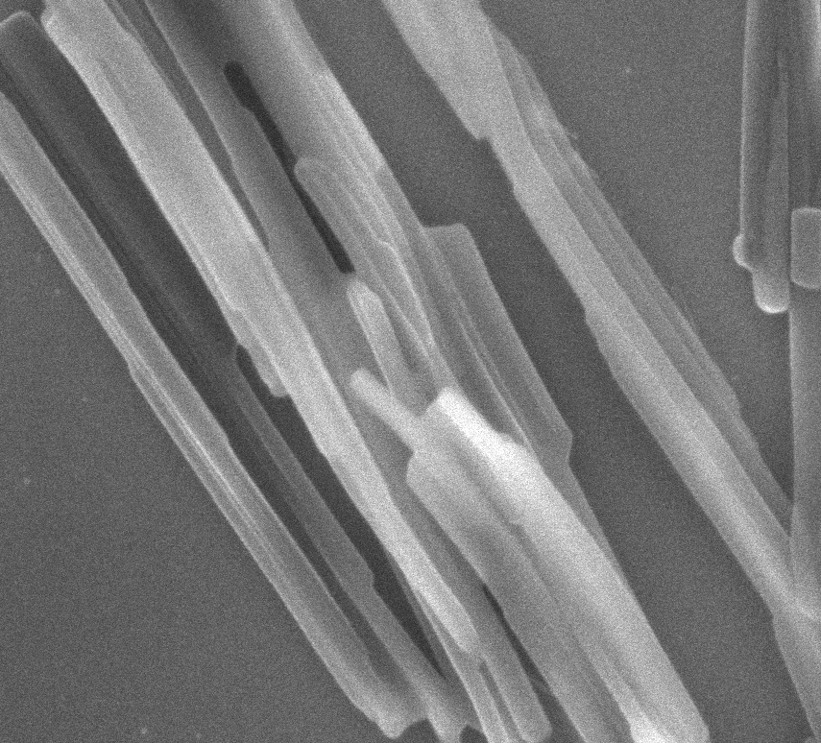
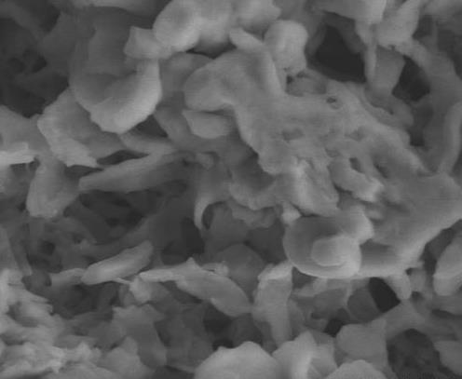
1-hexyne (Cu: Nanowire, Ag: Shapeless)
Cu (AS)
Cu
Diameter:
60 ± 14 nm
Length:
several μm
200 nm
Ag (AS)
*Recrystallization did not give
Ag-1-hexyne nanowire
5 μm
Notes:
6分30秒

Slide 14
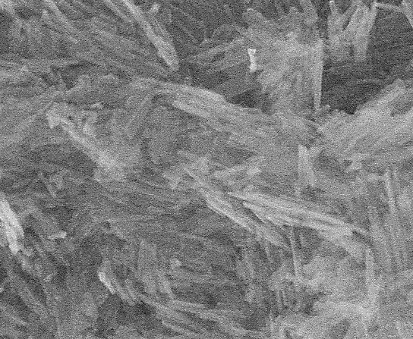
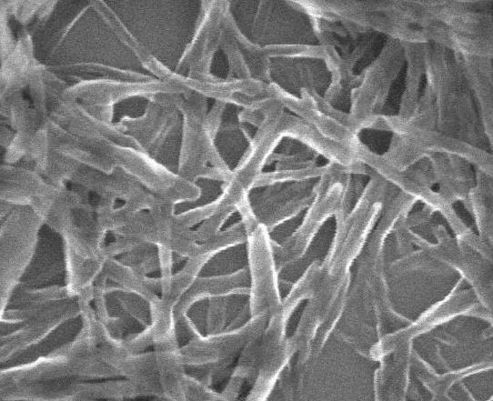
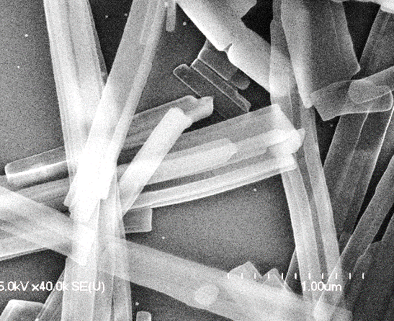
m-fluorophenylacetylene (Cu, Ag: nanowire)
Cu (AS), nanorod
Cu, nanowire(?),
MeOH+EtOH
500 nm
500 nm
Ag (AS), nanowire
Ag
Diameter:
127 ± 40 nm
Length:
～5 μm
1 μm
Notes:
7分

Slide 15
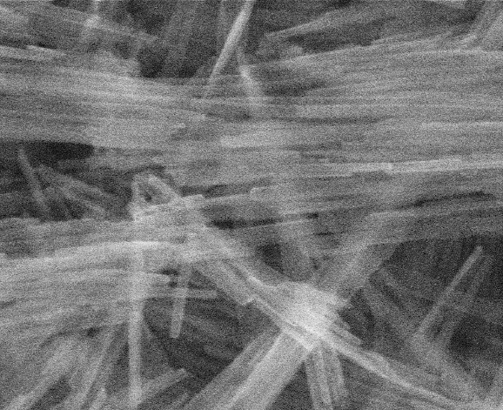
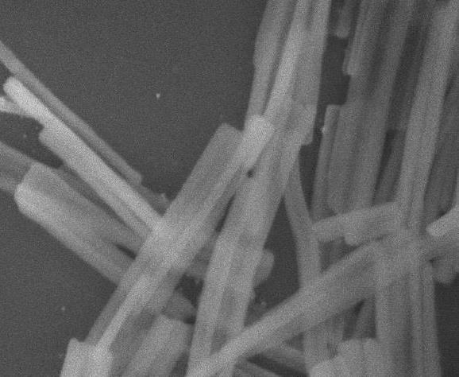
m-chlorophenylacetylene (Cu, Ag: nanowire)
Cu (AS), nanowire
Cu
Diameter:
41 ± 8 nm
Length:
few μm
1 μm
Ag (AS), nanowire
Diameter:
69 ± 16 nm
Ag
Length:
1-3 μm
1 μm
Notes:
7分30秒

Slide 16
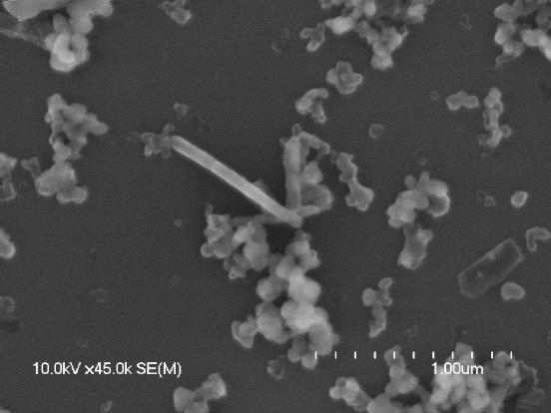
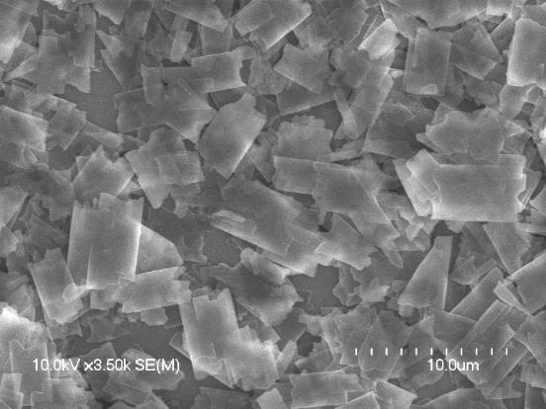
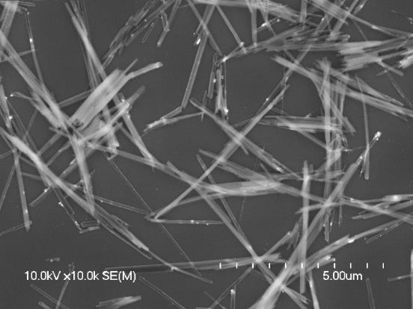
2-ethynylpyridine (Cu, Ag: nanowire)
Cu (AS), shapeless
*Recrystallization did not give
Cu-2-ethynylpyridine nanowire.
1 μm
Ag (AS), small plate
Diameter:
98 ± 28 nm
Ag, Nanowire, hexane
Ag
Length:
5-10 μm
10 μm
5 μm
Notes:
8分

Slide 17
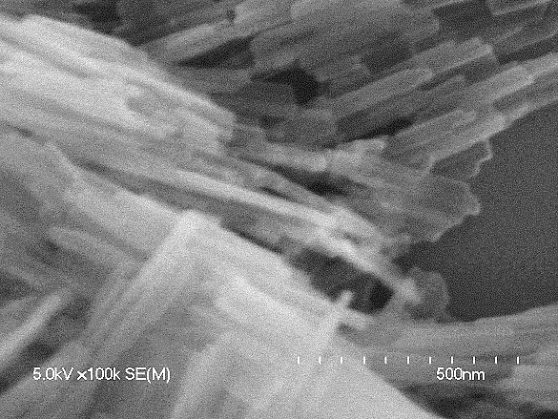
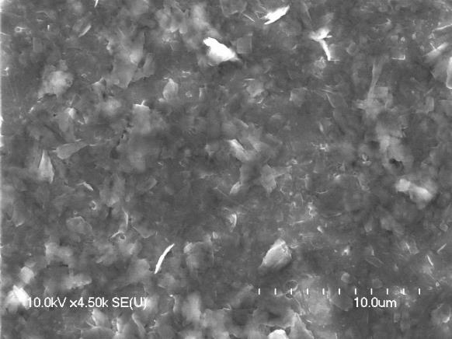
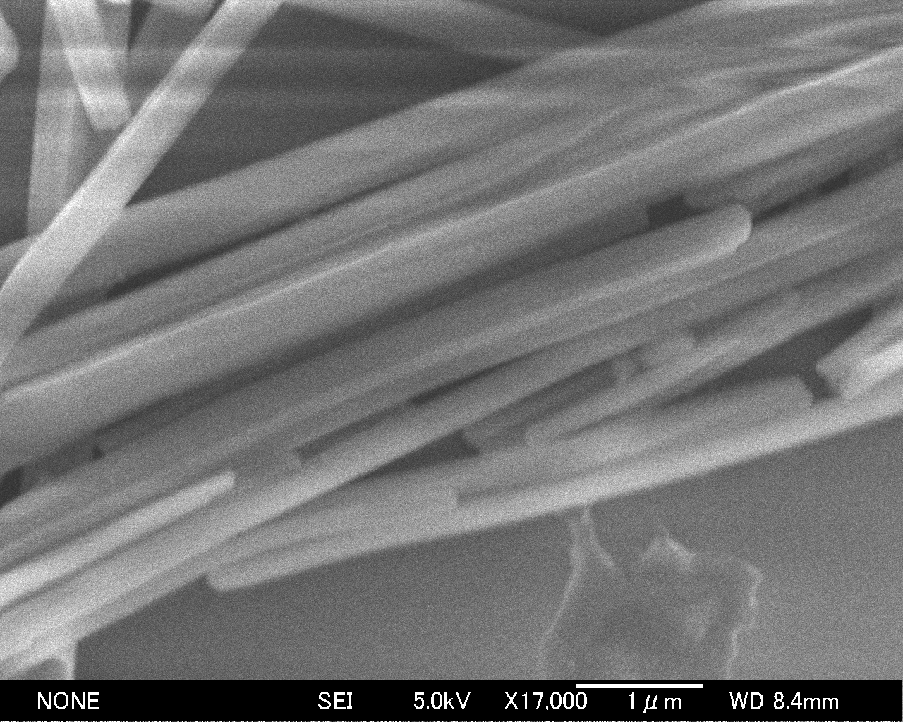
p-ethynyltoluene (Cu: nanorod, Ag: nanowire)
Cu (AS), nanorod
Diameter:
32 ± 7 nm
Cu
Length:
～500 nm
500 nm
Ag (AS), small plate
Ag
Diameter:
165 ± 42 nm
Ag, nanowire, 1-PrOH
Length:
10-20 μm
10 μm
1 μm
Notes:
8分30秒

Slide 18
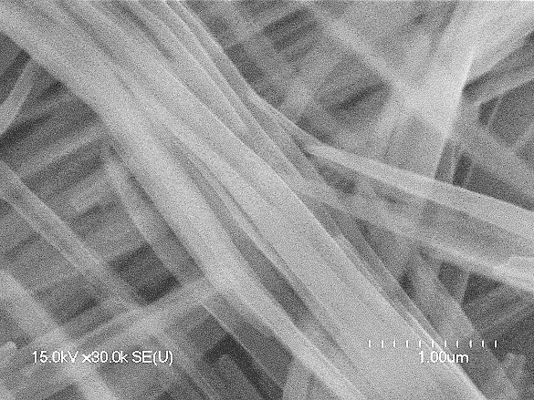
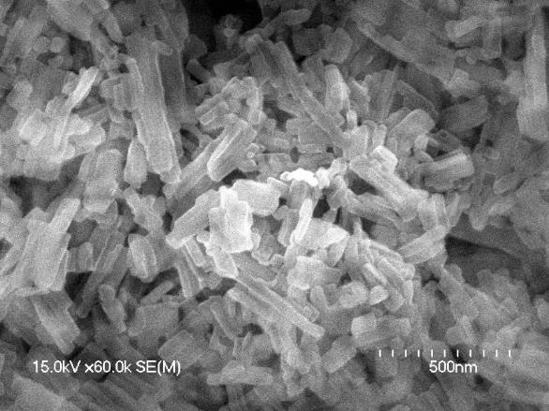
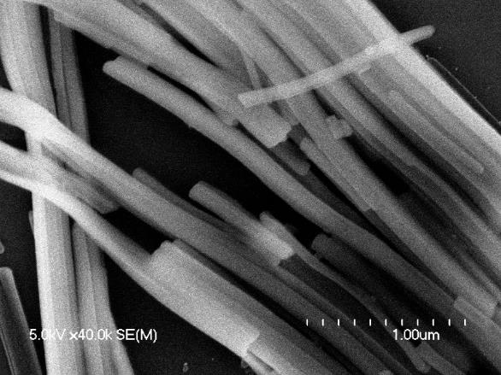
p-^{tert}Bu-phenylacetylene (Cu, Ag: nanowire)
Cu (AS), nanowire
Cu
Diameter:
84 ± 22 nm
Length:
5～10 μm
1 μm
Ag
Diameter:
81 ± 27 nm
Ag (AS), nanorod
Ag , nanowire, acetone
Length:
5～30 μm
500 nm
1 μm
Notes:
9分

Slide 19
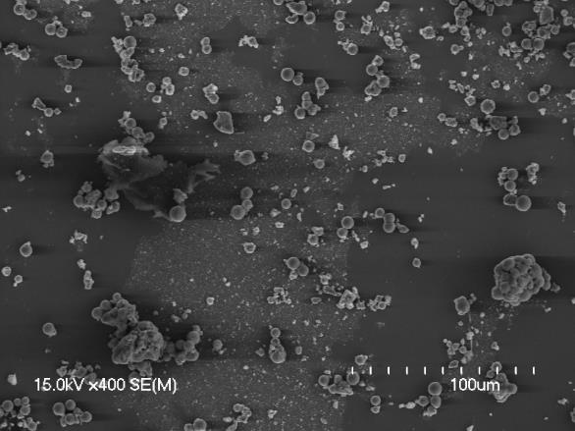
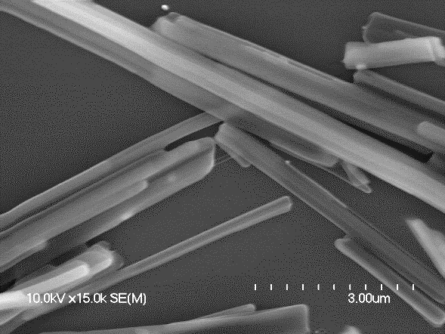
p-ethnylhexylbenzene (Cu: shapeless, Ag: nanowire)
Cu (AS), shapeless
*Recrystallization did not give
Cu-p-ethynylhexylbenzene
nanowire.
100 μm
Ag (AS), nanowire
Ag
Diameter:
250 ± 58 nm
Length:
5～15 μm
3 μm
Notes:
9分20秒

Slide 20
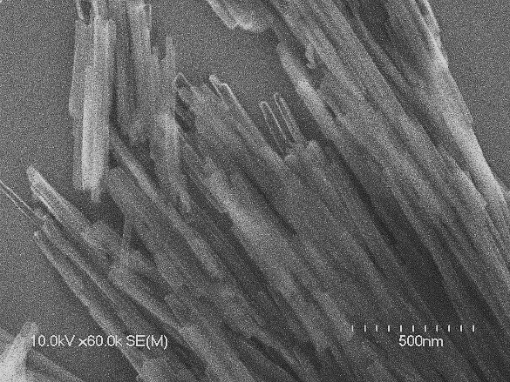
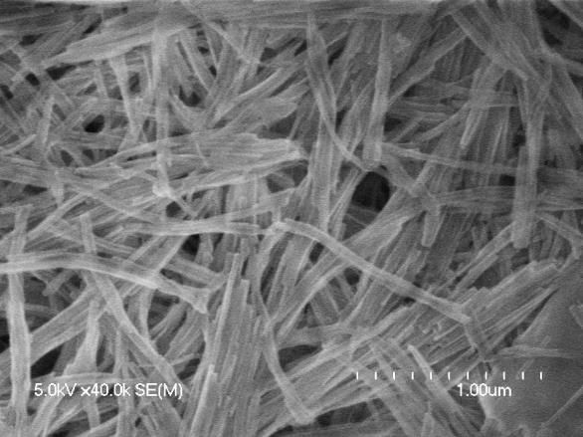
4-ethnylbiphenyl (Cu, Ag: nanowire)
Cu (AS), nanowire
Cu
Diameter:
38 ± 10 nm
Length:
～1 μm
500 nm
Ag (AS), nanowire
Ag
Diameter:
46 ± 11 nm
Length:
few μm
1 μm
Notes:
9分40秒

Slide 21
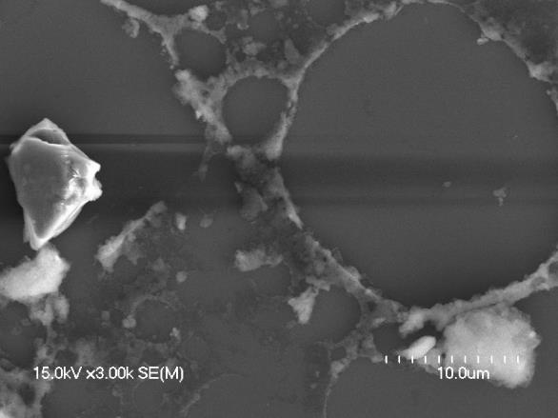
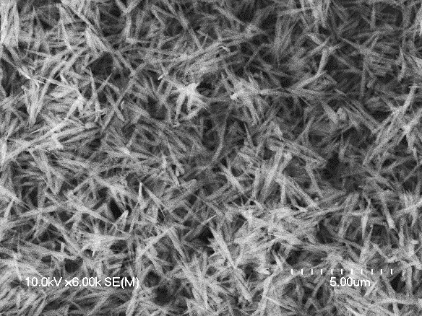
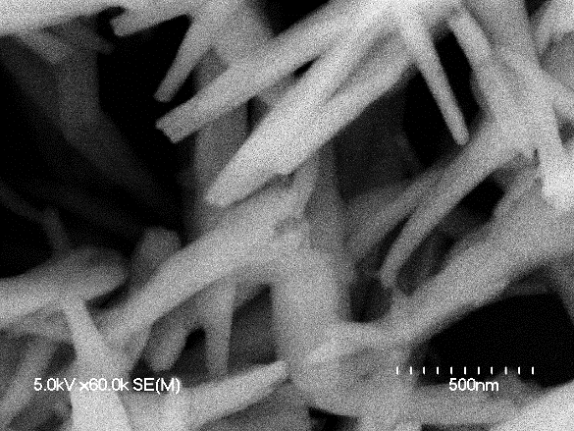
Phenyl propargyl sulfide (Cu: nanorod, Ag: decomp.)
Cu (AS), shapeless
CHCl₃ + toluene
10 μm
5 μm
Cu
Diameter:
92 ± 22 nm
Length:
～1 μm
500 nm
Notes:
10分

Slide 22
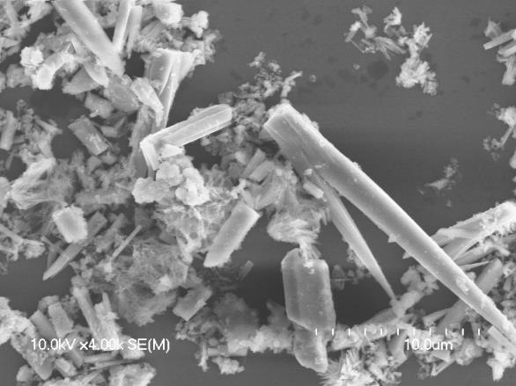
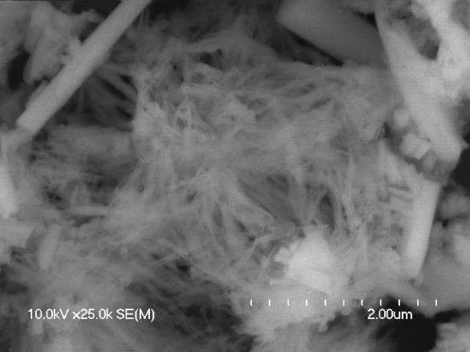
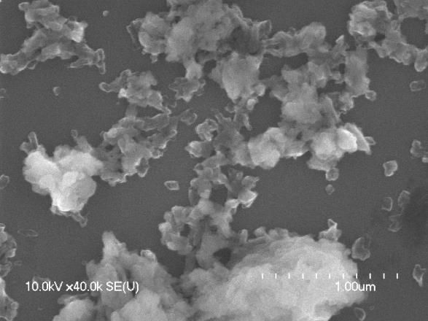
p-ethnylaniline (Cu: partially nanowire, Ag shapeless)
Cu (AS)
10 μm
2 μm
Ag (AS)
*We failed to recrystallize
these complexes.
1 μm
Notes:
10分20秒

Slide 23
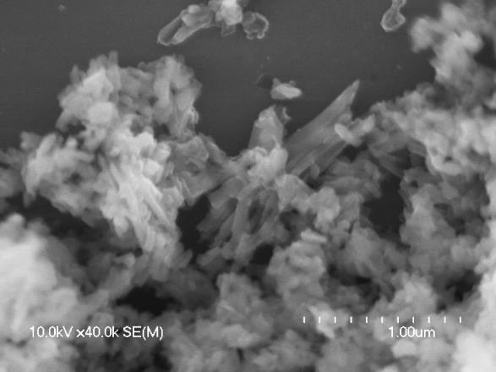
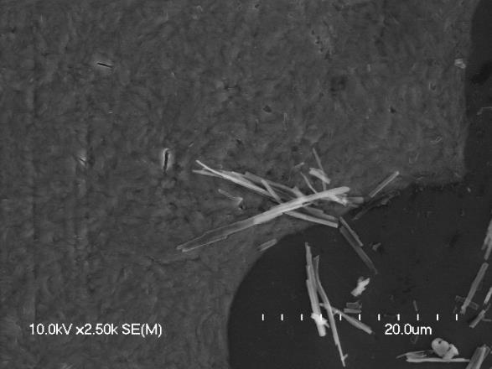
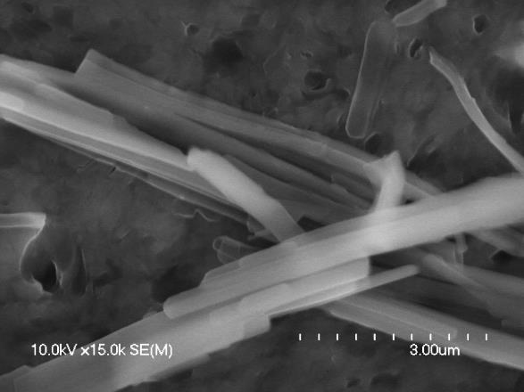
5-hexyne-1-ol (Cu: nanorod?, Ag partially nanowire)
Cu (AS)
*We failed to recrystallize
these complexes.
1 μm
Ag (AS)
Ag (AS)
20 μm
3 μm
Notes:
10分40秒

Slide 24
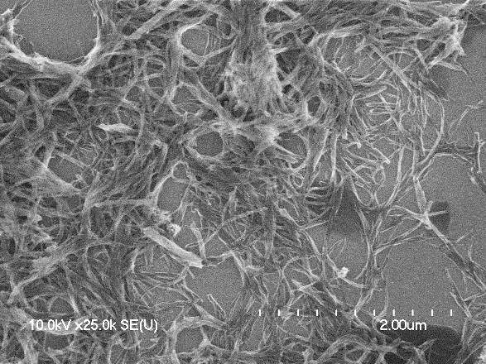
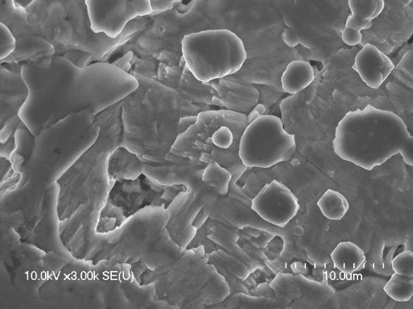
4-pentyne-2-ol (Cu, Ag: fused nanowire)
Cu (AS)
The complexes are essentially
nanowire, but they are melt and fused.
2 μm
Ag (AS)
*We failed to recrystallize
these complexes.
10 μm
Notes:
11分

Slide 25
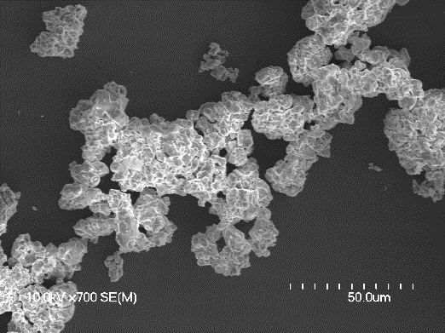
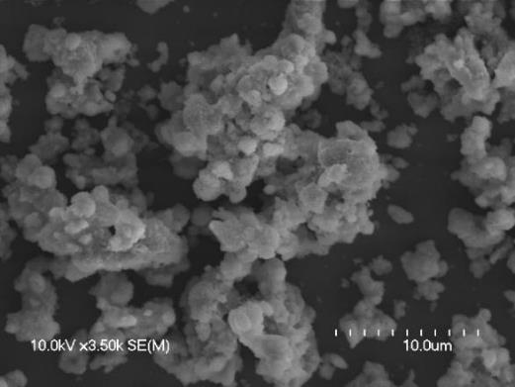
1-ethynyl-1-cyclohexanol (Cu, Ag: shapless)
Cu (AS), shapeless
Ag (AS), shapeless
50 μm
10 μm
*We failed to recrystallize these complexes.
6-chloro-1-hexyne (Cu, Ag: decomposed)
1-diethylamino-2-propyne (Cu, Ag: decomposed)
Notes:
11分20秒

Slide 26
Nanowire
Nanorod
Partially nanowire/nanorod
Shapeless nanoparticle
Decomposed
Notes:
12分

Slide 27
Is it possible to prepare
functional nanowires by this method?

Slide 28
Organic radical
(magnetic)
Fluorescent
Notes:
12分

Slide 29
Results and Discussion 2
(functional nanowires)

Slide 30
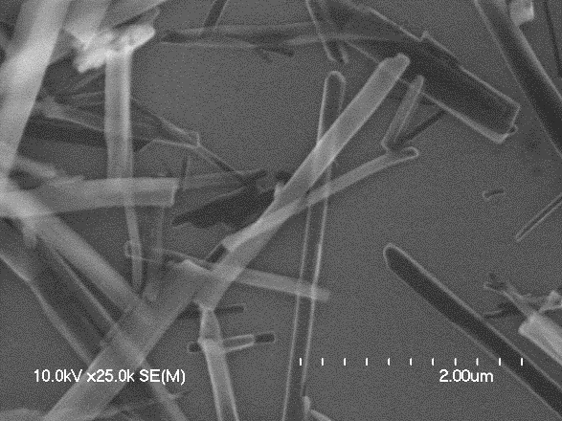
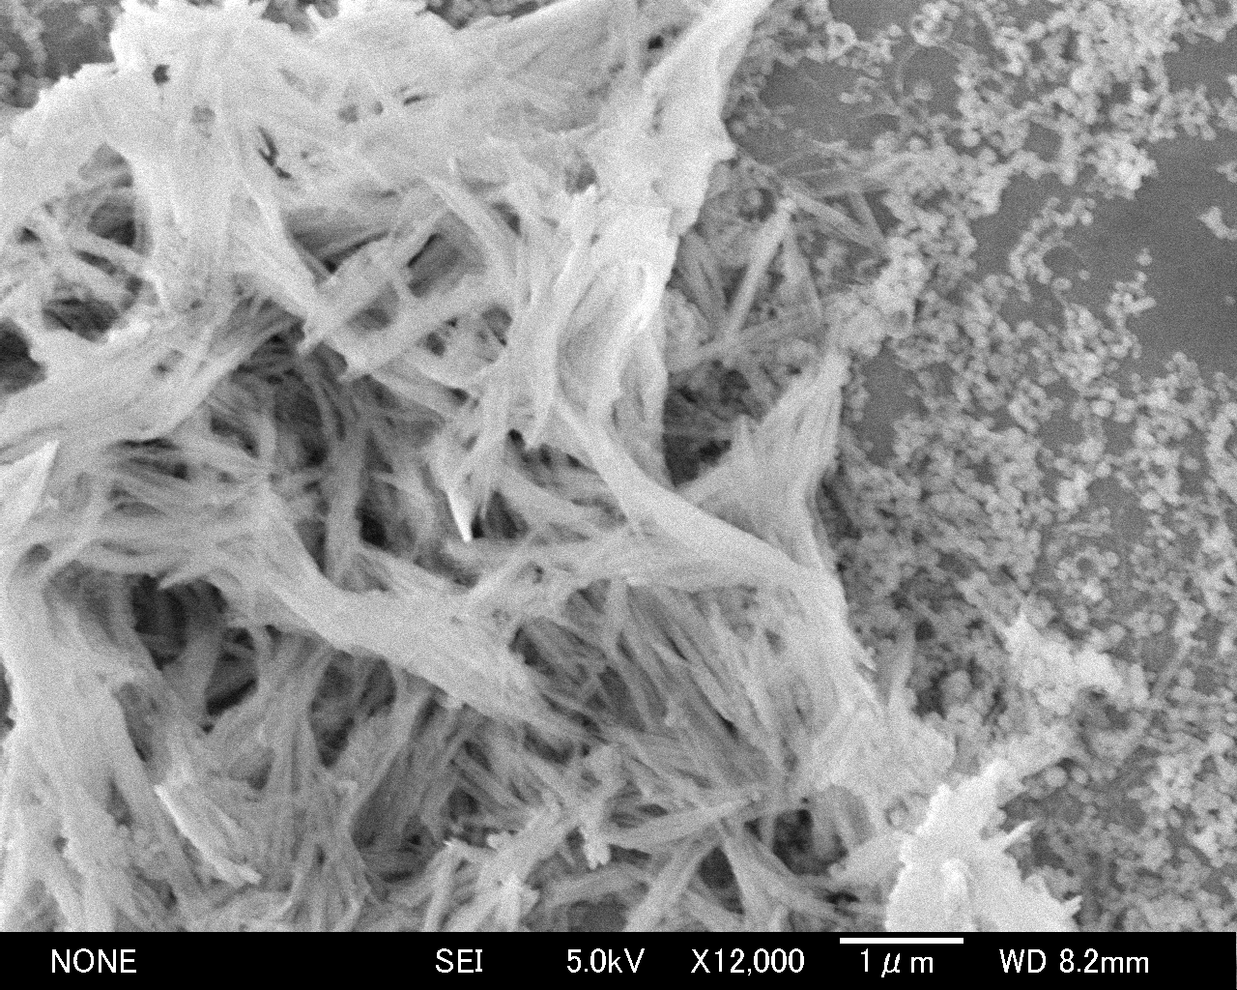
1. Organic radical (4-ethynyl-1-phenyl-NN)
Cu(recryst.), CH₃CN
2 μm
Cu
Diameter:
145 ± 48 nm
Ag (recryst.), CH₂Cl₂+Et₂O
Length:
5-20 μm
1 μm
Notes:
12分30秒

Slide 31
Magnetic susceptibility
χT ∼ 0.375 emu K /mol
(at high temperature)
One spin per one ligand
Magnetic
Nanowire
Notes:
12分50秒

Slide 32
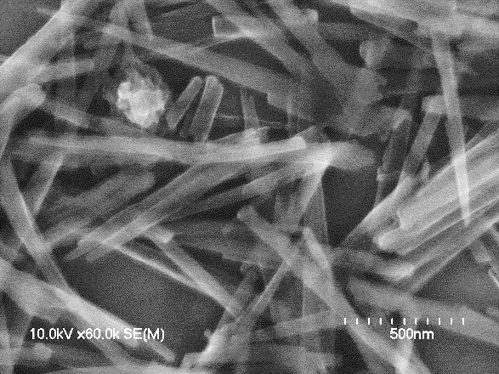
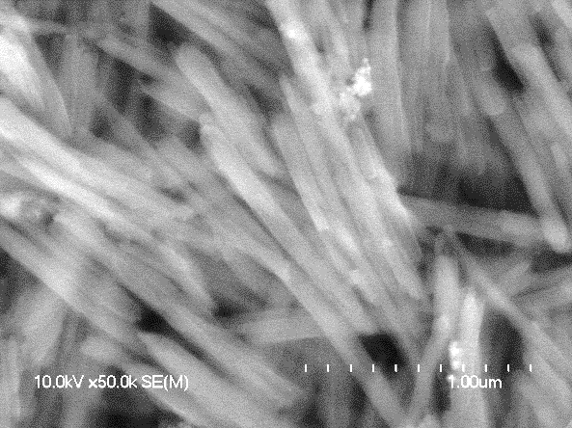
2. Fluorescent molecule (9-Ethynylphenanthrene)
Cu (recryst.), hexane
Cu
Diameter:
65 ± 15 nm
Length:
1～2 μm
500 nm
Ag (recryst.), hexane
Ag
Diameter:
90 ± 18 nm
1 μm
Length:
1-3 μm
Notes:
13分20秒

Slide 33
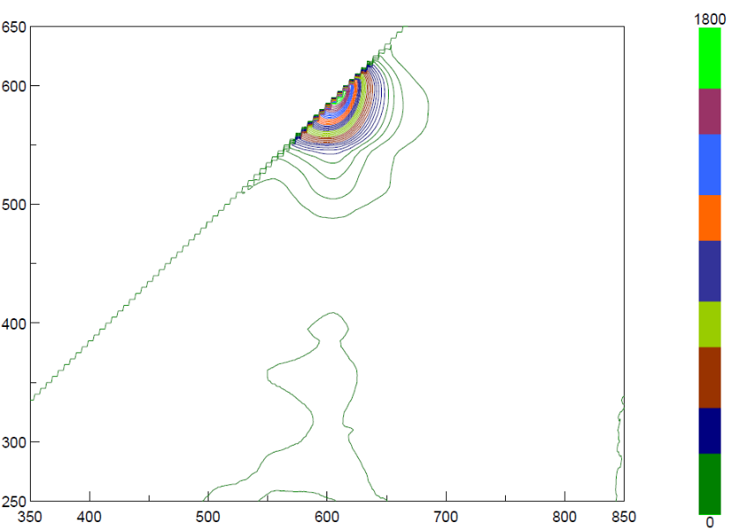
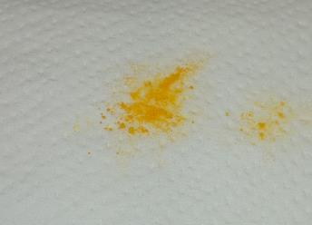
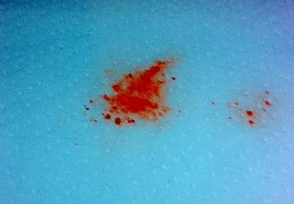
Fluorescence
Cu complex: fluorescent
(Ag complex is not fluorescent)
Vis
Excitation wavelength
UV
Emission wavelength
Fluorescent Nanowire
Notes:
13分50秒

Slide 34
Notes:
14分10秒

Slide 35
Conclusion

Slide 36
Nanowire
Nanorod
Partially nanowire/nanorod
Shapeless nanoparticle
Decomposed
Notes:
14分30秒

Slide 37
Conclusion 1: Applicability of the method
・The present method was successful in producing nanowires from various organic molecules.
"Versatile method to construct nanowires"
・The existence of an aromatic ring probably promotes the formation of nanowires.
・Hydroxyl group and nitrogen atom may hinder the formation of nanowires.
→ coordination affect a crystal structure?
Notes:
14分50秒

Slide 38
Conclusion 2: Construct functional nanowires
・The present method is applicable to large and functional molecules such as nitronyl-nitroxide and phenanthrene.
・The functions of the molecules are maintained even in the nanowires.
New method to construct functional nanowires
Notes:
15分10秒

Slide 39
Acknowledgement
We are grateful to Dr. M. Enomoto (Tokyo Univ. of Sci.) for his cooperation in the magnetic measurements.
Notes:
15分30秒

